Slide 1
Evolution of the MW/M31 Bulges during and after Merger
Tyler Baines

Slide 2
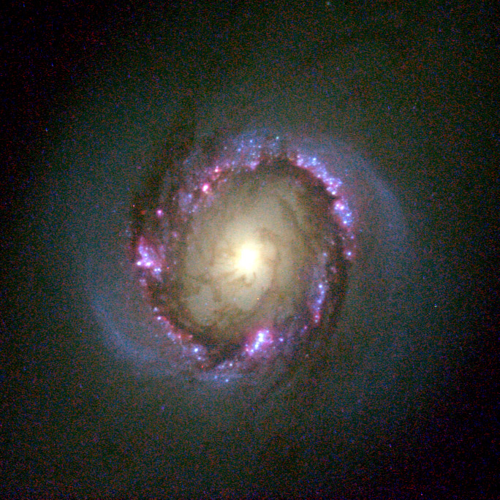
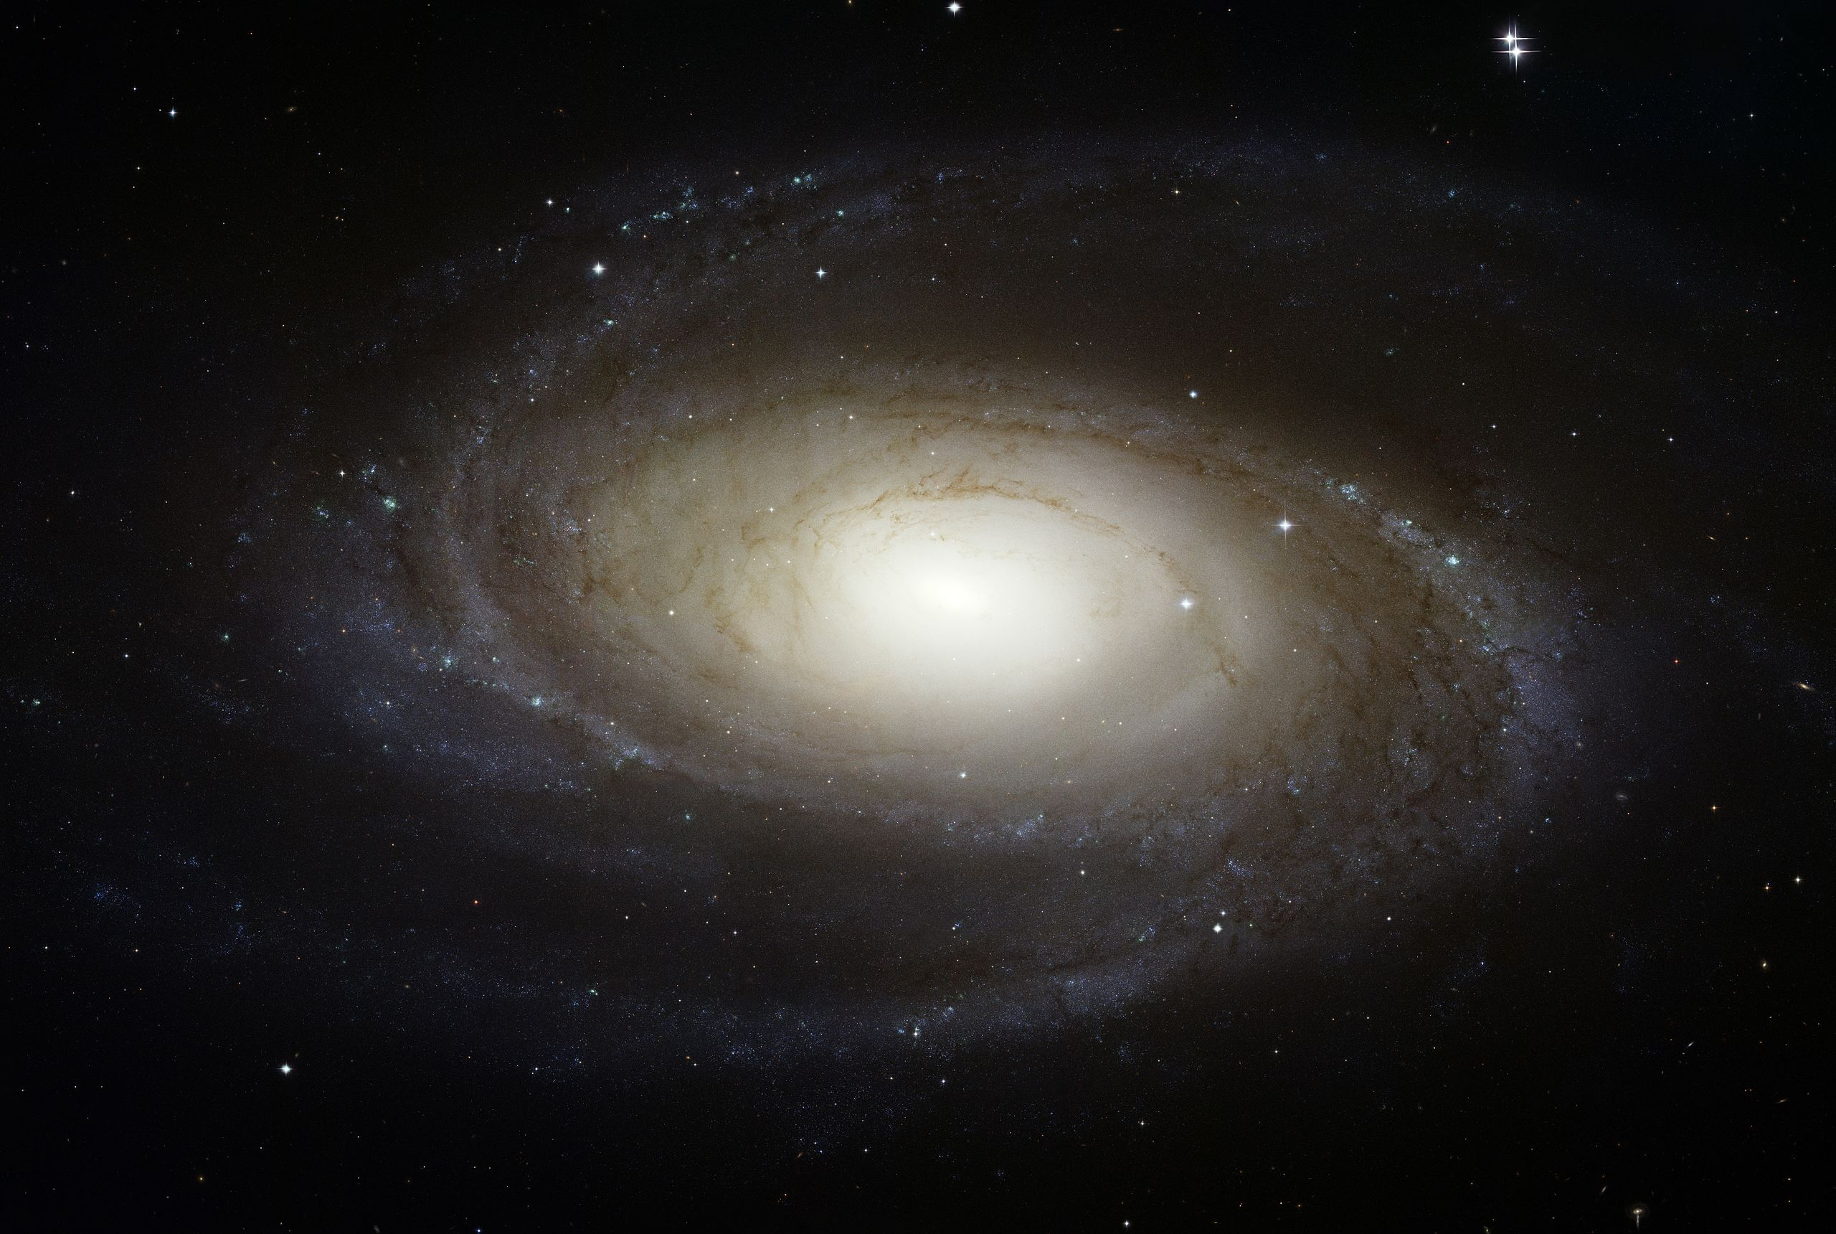
Observational Properties
Divided into two types:
Classical Bulge
Pseudobulges
Credit: NASA, ESA and the Hubble Heritage Team (STScI/AURA)

Slide 3
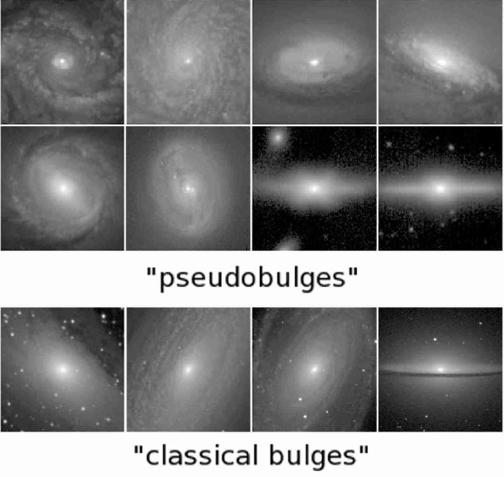
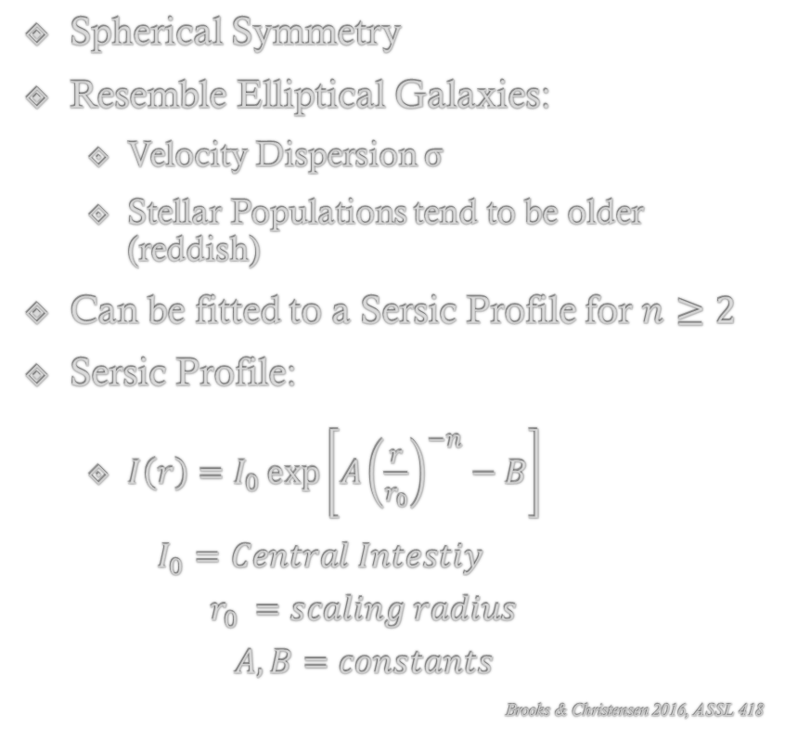
Classical Bulges
Spherical Symmetry
Resemble Elliptical Galaxies:
Velocity Dispersion σ
Stellar Populations tend to be older (reddish)
Can be fitted to a Sersic Profile for $n≥2$
Sersic Profile:
$I\left(r\right)=I_{0}\exp\left[{A\left(\frac{r}{r_{0}}\right)}^{−n}−B\right]$
$I_{0}=Central Intestiy$
$$r_{0 }=scaling radius$$
$$A,B=constants$$
Brooks & Christensen 2016, ASSL 418
Credit: https://ned.ipac.caltech.edu/level5/Sept11/Buta/Buta9.html

Slide 4
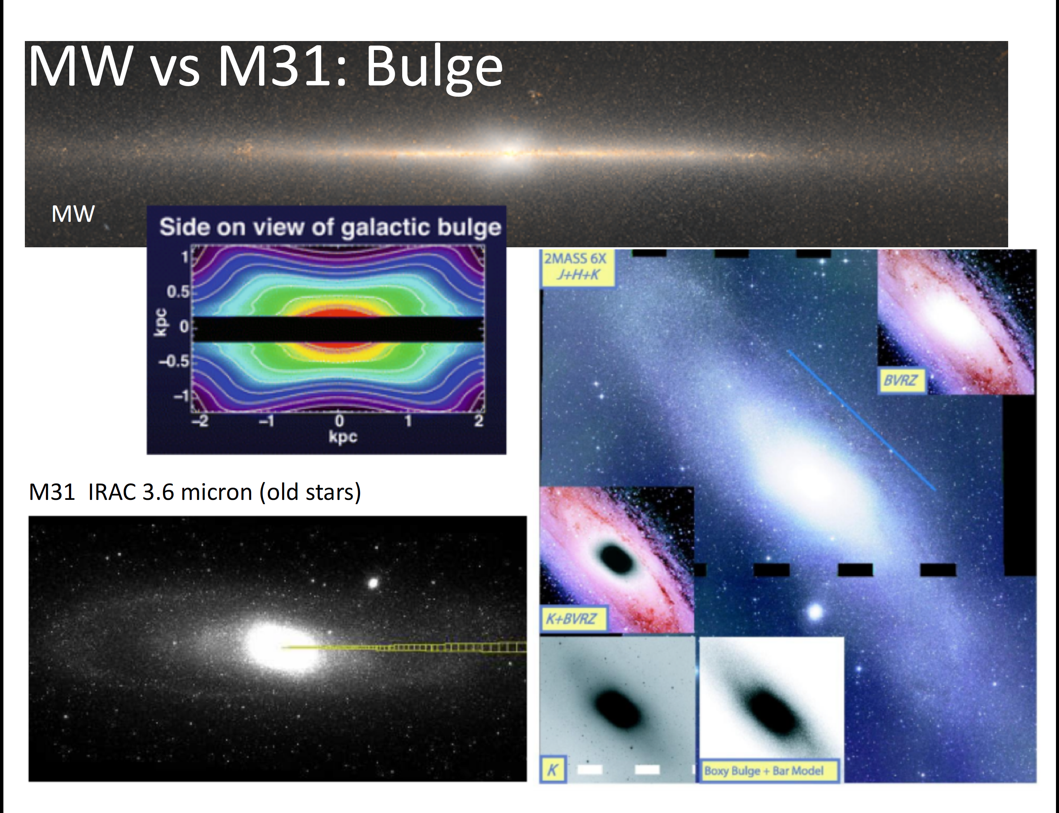
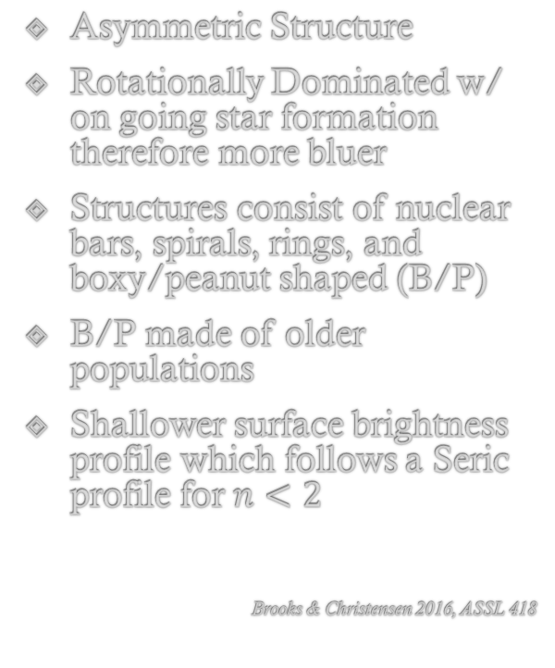
Pseudobulges
Asymmetric Structure
Rotationally Dominated w/ on going star formation therefore more bluer
Structures consist of nuclear bars, spirals, rings, and boxy/peanut shaped (B/P)
B/P made of older populations
Shallower surface brightness profile which follows a Seric profile for $n<2$
Brooks & Christensen 2016, ASSL 418
Besla, Slide 21 Lecture 6

Slide 5
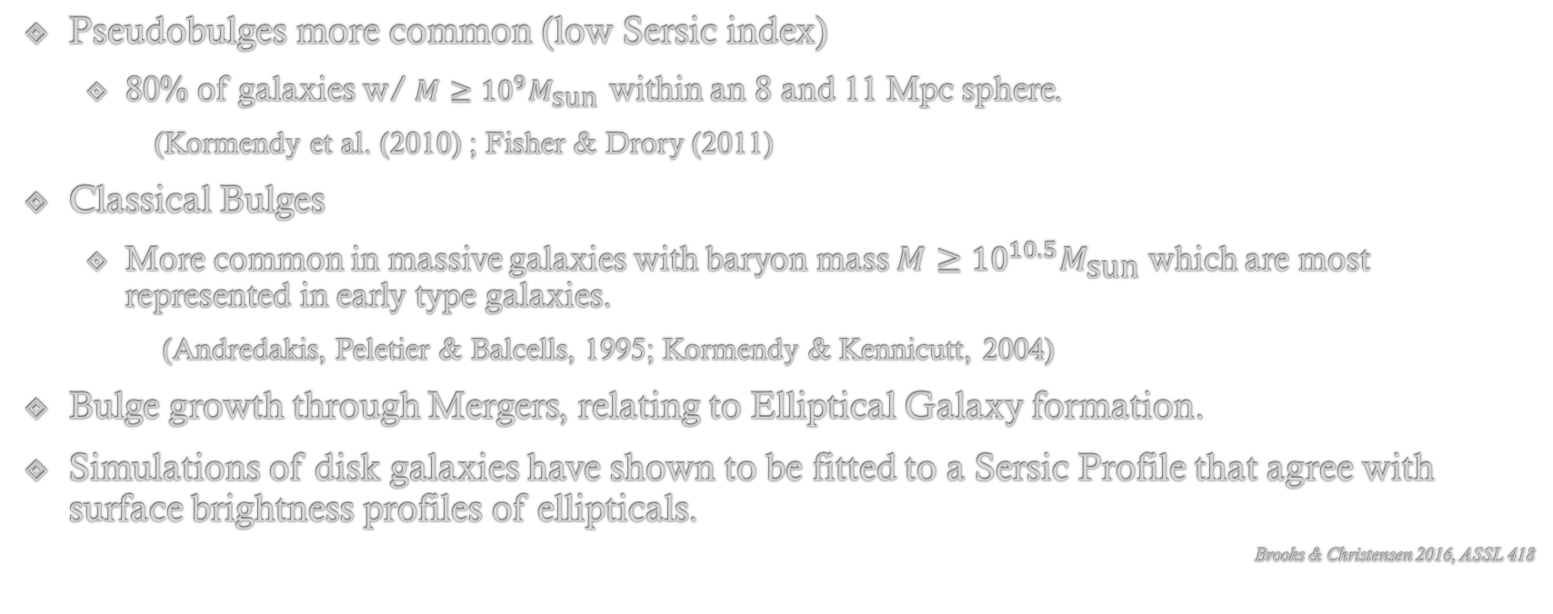
Some Current Understandings
Pseudobulges more common (low Sersic index)
80% of galaxies w/ $M≥{10}^{9}M_{\text{sun}}$ within an 8 and 11 Mpc sphere.
(Kormendy et al. (2010) ; Fisher & Drory (2011)
Classical Bulges
More common in massive galaxies with baryon mass $M≥{10}^{10.5}M_{\text{sun}}$ which are most represented in early type galaxies.
(Andredakis, Peletier & Balcells, 1995; Kormendy & Kennicutt, 2004)
Bulge growth through Mergers, relating to Elliptical Galaxy formation.
Simulations of disk galaxies have shown to be fitted to a Sersic Profile that agree with surface brightness profiles of ellipticals.
Brooks & Christensen 2016, ASSL 418

Slide 6
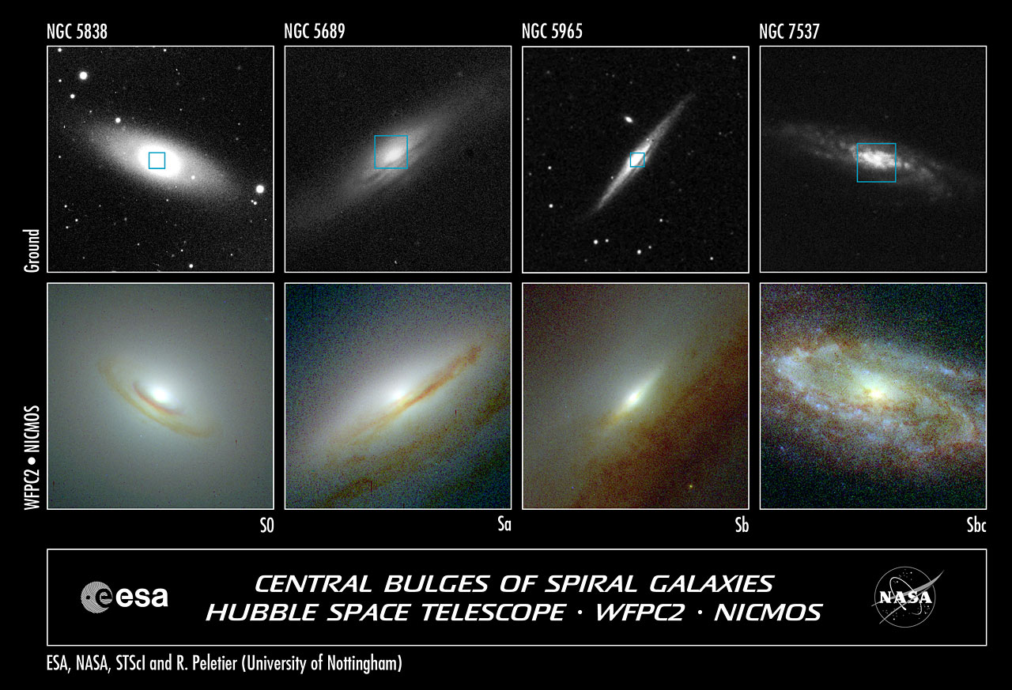
My Questions
How does the evolution of the kinematics of MW/M31 Merger event compare to its Remnant?
Such as:
How are the density profiles changing with time?
Do the galaxy support rotational or disperision kinematics?
Does the morphology change at all?
Is it spherical or asymmetric? Classical or Pseudo?
Does the viral theorem hold for the Remnant?
Is it dynamically stable?

Slide 7
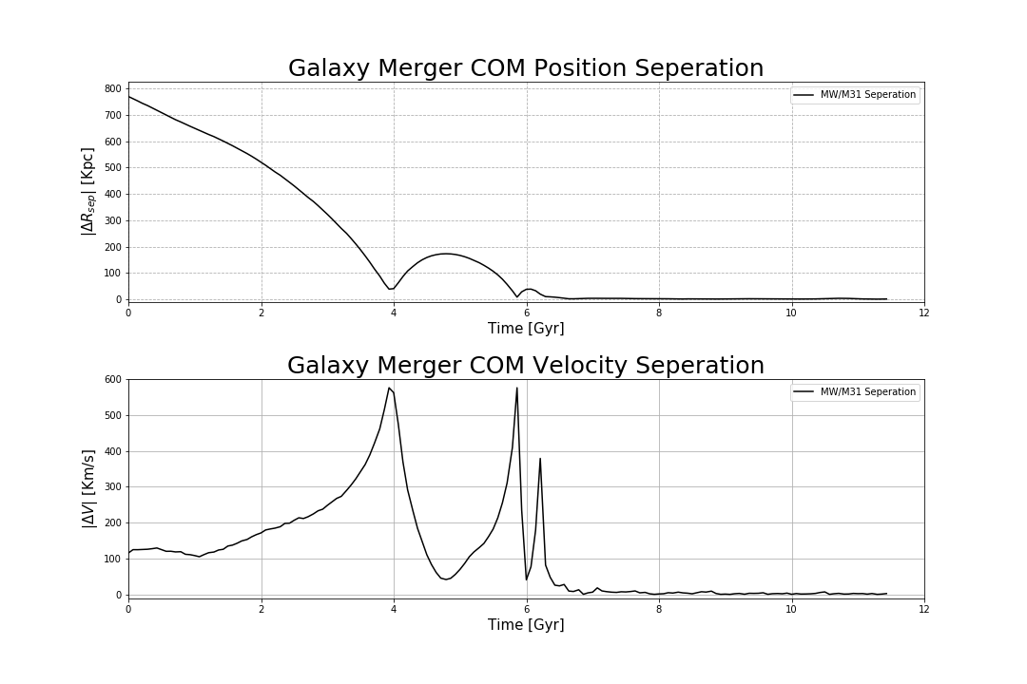
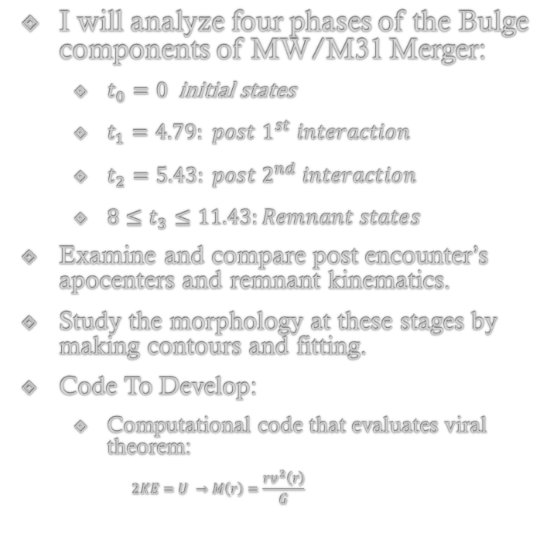
How will I use the simulation data to answer each of these questions?
I will analyze four phases of the Bulge components of MW/M31 Merger:
$t_{0}=0$ initial states
$t_{1}=4.79: {post 1}^{st} interaction$
$t_{2}=5.43: {post 2}^{nd} interaction$
$8≤t_{3}≤11.43:Remnant states$
Examine and compare post encounter’s apocenters and remnant kinematics.
Study the morphology at these stages by making contours and fitting.
Code To Develop:
Computational code that evaluates viral theorem:
$$2KE=U →M\left(r\right)=\frac{rv^{2}\left(r\right)}{G}$$

Slide 8
Predictions
Particles to be loosely bounded and diffuse in remnant with bulge growth and density profile to have similar structure to the initial states.
Density profile follows a power law.
Has a Sersic profile n > 2
Morphology: Symmetric near center and Asymmetric outer regions, more elliptical.
Remnant supports dispersion rather than rotational motion.

Slide 9
Questions

